Slide 1
Drug Review Analysis
5510: Unsupervised Learning project
Notes:
The project is based on a study of drug reviews against a disease or condition with the medication taken. The ratings are also provided for these observations as a separate feature. The project is part of Unsupervised learning 5510.

Slide 2
Sequence
1. About the Dataset
2. Data Overview
3. Data Cleaning
4. EDA
5. Models Design
6. NMF Optimization
7. Results and Analysis
8. Conclusion
Notes:
The sequence of the presentation is going to be as follows.

Slide 3
About the dataset
UCI Repository
Reviews and Ratings for various drugs
Train and Test Set
Predict Ratings
Citation: Felix Gräßer, Surya Kallumadi, Hagen Malberg, and Sebastian Zaunseder. 2018. Aspect-Based Sentiment Analysis of Drug Reviews Applying Cross-Domain and Cross-Data Learning
Notes:
The data has been taken from UCI repository and is regarding the use of a drug type for some medical condition alongwith the reviews and ratings from the user. The data was collected from various pharmaceutical company websites. There are 2 files which had been compiled for analysis as train and test data. The data percentages of train and test was set to 75% and 25% respectively.
The objective of the project is whether we can predict the rating a user is likely going to give depending on the review submitted. This is essentially a classification problem which would be adressed by using unsupervised machine learning approach. A comparison would also be done against some machine learning models to access the effectiveness of the unsupervised model vs supervised model. The target variable is rating with the possible ratings between '1' and '10'.

Slide 4
Data overview
Train Data
161297 Observations / 7 Features
Test Data
53766 Observations / 7 Features
Data types
Data Size
Notes:
The training dataset has 161297 observations against 7 features whereas the test dataset has 53766 observations against the same 7 features.
The size of training is 8.6mb and test 2.9mb.
The datset contains 4 object types, 2int types and 1 float i.e. the ratings.
There are a total of 7 features in both the datasets namely:
drugName (categorical): name of drug
condition (categorical): name of condition
review (text): patient review
rating (numerical): 10 star patient rating
date (date): date of review entry
usefulCount (numerical): number of users who found review useful

Slide 5


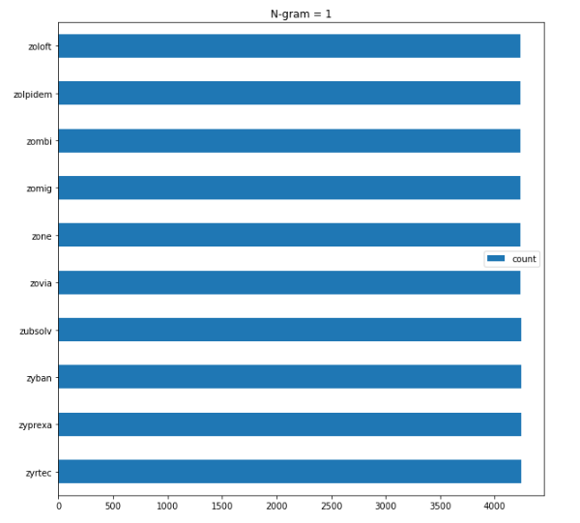
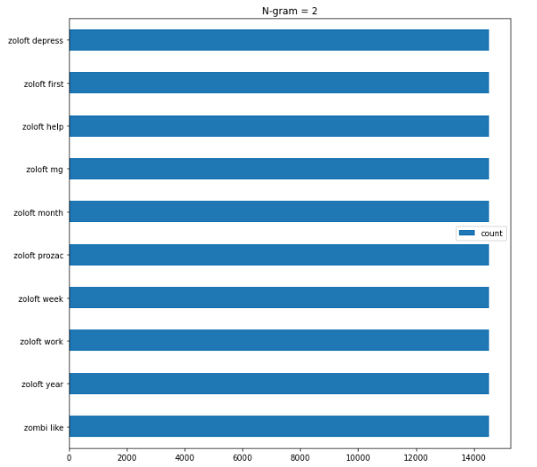
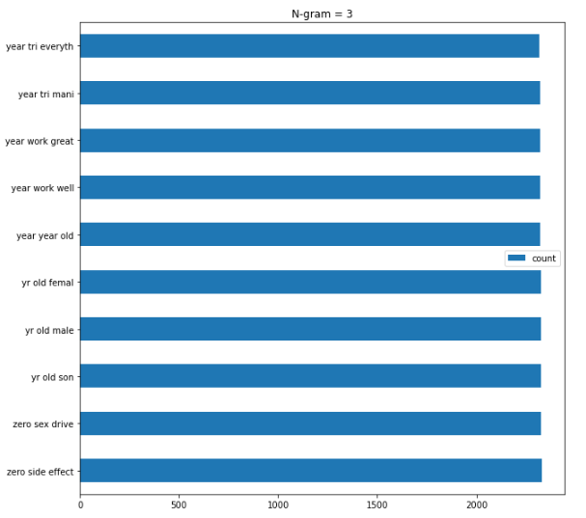
Data cleaning
Dropping Columns
NA values
Processing Reviews (text)
Nltk library
N-gram Analysis
Notes:
Since, our objective for the project is to be able to predict the ratings based on the user review, we will be getting rid of the remaining columns.
There were no missing values in our data. Our data now consists of only 2 columns namely reviews and ratings.
After limiting to the data that we required, we started off with the preprocessing of review text. The nltk library was used here to remove the stop words in coordination
With other steps such as removing alpha numerics, puncuations, stemming and lemmatization.
The data was then vectorized using tfidf vectorizer and an analysis based on n-grams was carried out upto n-gram set to 3.
We can see from the graphs that the name of the medicine is most occuring in the data when the min occurence is set a 50 whereas the time and effect are mostly displayed when we are refering to the ngrams set to 3.

Slide 6
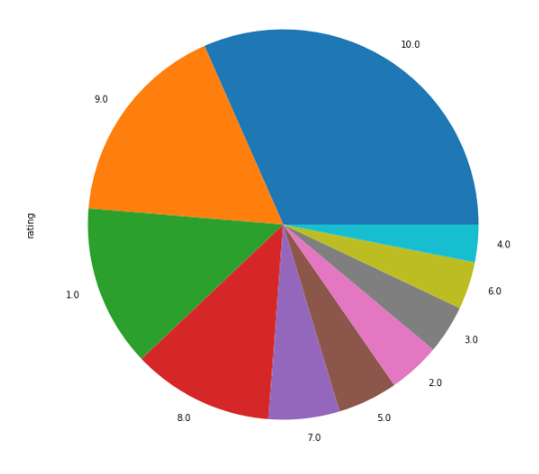
EDA
Ratings Division
Common Words in Rating brackets
Modifying Ratings
Counter Word Redundancy
Counter Data Skewness
Notes:
In the initial phase, we assed the division of the ratings across the various markings. We found that ratings are not equally distributed and this would in turn would comprosmise the accuracy of any model. Moreover, we also found that the words were quite similar to each other in various brackets of the ratings. Hence, in order to counter skewness and redundancy of words in the various rating brackets, we grouped them together into 3 categories. From, this we would have ample amount of data on each rating to train an acceptable model.s

Slide 7
Model design
Non Zero Matrix Factorization
Train Data : 28%
Test Data : 28%
Random Forest
Train Data : 80%
Test Data : 79%
Naïve Bayes
Train Data : 60%
Test Data : 60%
Notes:
NMF:The first model that we trained was the Non-Zero Matrix Factorization of the complete train data. The reason we took the entire data was it is not effected by any kind of overfitting since the data will not be based on any initial set outcome. After training the data and testing it on the train data we got an accuracy of a mere 28%. We then tested it on the actual test data provided as well which also gave an accuracy of 28%. This tends us to believe that the nmf is not really a good choice here with the lack of accuracy it is showing in both the datasets.
Random Forest: The Random forest model seemed to give the best result with an accuracy of 80% on the train set and 79% on the test set. These accuracies are quite near which indicates that the model is substantially good fit without any overfitting taking place.
Naive bayes: The naive Bayes model seems to fall in between the Random Forest and NF in terms of performance with a constant accuracy of 60% on both the train and test set.

Slide 8
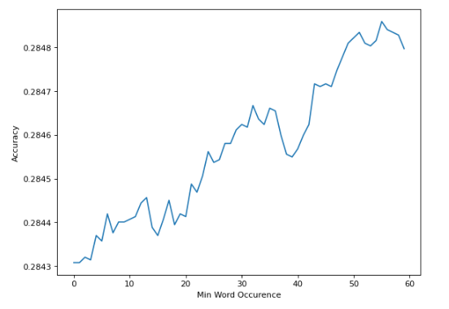

NMF Optimization
Min Word Occurrence
Hyperparameters
Initialization
random
Loss Function
Kullback Leibler
Concatenation
41 % Accuracy
Notes:
We later tried to optimize the NMF by optimizing the minimum acceptable word occurence whcih came out to be at '55'. We also went over the various init types and loss function to identify the best parameters. From these, we found that the best init was set at 'random' with the loss function at 'kullback leibler'. Once we set these new parameters and joined both the train the test set for enhanced accuracy, we got an accuracy of 41% which is mark difference from our initial model but still is not accuracte enough.

Slide 9
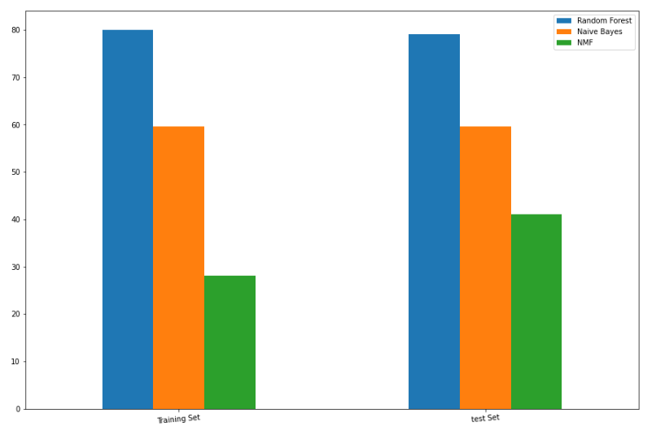
Result and Analysis
Random Forest Selected
Default Hyperparameters optimal
NMF Substantial Improvement
Hyperparameters
Data concatenation
Notes:
The final selected model is Random Forest which seems to be performing the best in both the training data and the test data. The accuracy for each data is as follows:
Train Data : 80 %
Test Data : 79%
The various max_features fo random forest was also attempted which found that the default parameter setting of the Random Forest seems to be giving the best result and thus does not require any modification in terms of the features. There is one thing to note however in the above graph that NMF showed quite an improvement when the parameters were fine tuned. This in conjunction with further improvement in the text processing can probably be improved to produce much better results.

Slide 10
Conclusion
Time Complexity
Scalability
Text Processing
Notes:
In this project, multiple models were used to train the data both supervised and unsupervised learning methods. Both supervised learning models seemed to do better than the unsupervised learning method. However, it is important to note that the Matrix Factorization took a lot less time in model training and prediction as compared to the supervised learning method. The most important takeaway from this project was the need to properly clean the text. Many attempts were used to correctly identify the noise from the data to improve accuracy as well as time complexity. However, it is felt that the data still has a lot of room for improvement since many digits remained integrated with words which increased the time complexity and degraded the model overall accuracy.

Slide 11
Thank you

